Slide 1
Chapter 06 Normalization of Database Tables

Slide 2
Chapter 6
Normalization of Database Tables

Slide 3
Learning Objectives
In this chapter, you will learn:
What normalization is and what role it plays in the database design process
About the normal forms 1NF, 2NF, 3NF, BCNF, and 4NF
How normal forms can be transformed from lower normal forms to higher normal forms
That normalization and ER modeling are used concurrently to produce a good database design
That some situations require denormalization to generate information efficiently

Slide 4
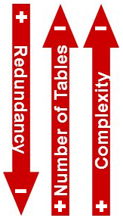
Database Tables and Normalization
Normalization is a process for assigning attributes to entities. It reduces data redundancies and helps eliminate the data anomalies.
Normalization works through a series of stages called normal forms:
First normal form (1NF)
Second normal form (2NF)
Third normal form (3NF)
Boyce-Codd normal form (BCNF)
Fourth normal form (4NF)
Fifth normal Form (5 NF)
Domain Key normal form (DKNF)
The highest level of normalization is not always desirable.

Slide 5
Database Tables and Normalization
The Need for Normalization
Case of a Construction Company
Building project -- Project number, Name, Employees assigned to the project.
Employee -- Employee number, Name, Job classification
The company charges its clients by billing the hours spent on each project. The hourly billing rate is dependent on the employee’s position.
Periodically, a report is generated.
The table whose contents correspond to the reporting requirements is shown in Table 5.1.

Slide 6
Scenario
A few employees works for one project.
Project Num : 15
Project Name : Evergreen
Employee Num : 101, 102, 103, 105

Slide 7
Sample Form
Project Num : 15
Project Name : Evergreen
Emp Num | Emp Name | Job Class | Chr Hours | Hrs Billed | Total
101
102
103
105

Slide 8

Sample Report Layout

Slide 9
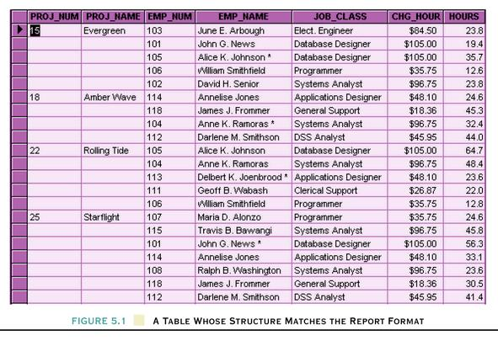
Table Structure Matches the Report Format

Slide 10
Database Tables and Normalization
Problems with the Figure 5.1
The project number is intended to be a primary key, but it contains nulls.
The table displays data redundancies.
The table entries invite data inconsistencies.
The data redundancies yield the following anomalies:
Update anomalies.
Addition anomalies.
Deletion anomalies.

Slide 11
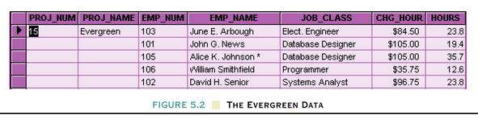
Database Tables and Normalization
Conversion to First Normal Form
A relational table must not contain repeating groups.
Repeating groups can be eliminated by adding the appropriate entry in at least the primary key column(s).

Slide 12
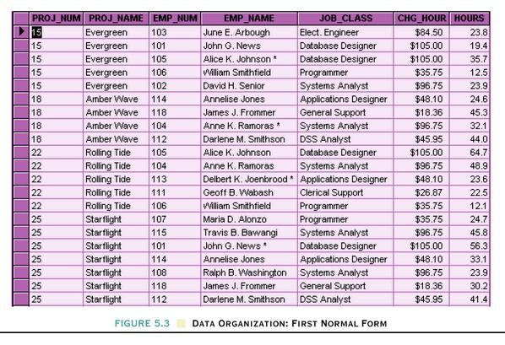
Data Organization: First Normal Form
After
Before

Slide 14
First Normal Form (1 NF)
1NF Definition
The term first normal form (1NF) describes the tabular format in which:
All the key attributes are defined.
There are no repeating groups in the table.
All attributes are dependent on the primary key.

Slide 15
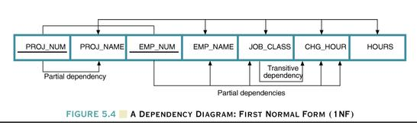
Dependency Diagram
Dependency Diagram
The primary key components are bold, underlined, and shaded in a different color.
The arrows above entities indicate all desirable dependencies, i.e., dependencies that are based on PK.
The arrows below the dependency diagram indicate less desirable dependencies -- partial dependencies and transitive dependencies.

Slide 16
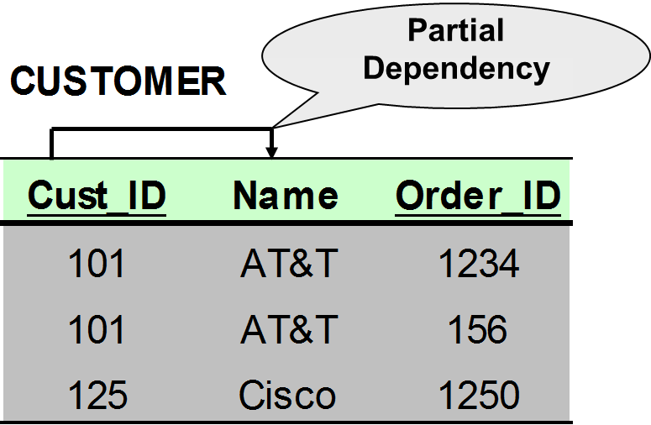
Functional Dependencies
Partial Dependency – when an non-key attribute is determined by a part, but not the whole, of a COMPOSITE primary key (The Primary Key must be a Composite Key).
Cust_ID → Name

Slide 17
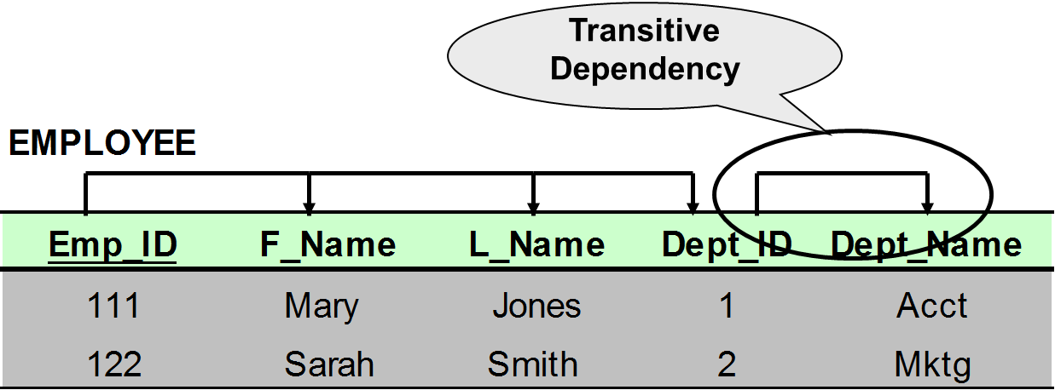
Functional Dependencies
Transitive Dependency – when a non-key attribute determines another non-key attribute.
Dept_ID → Dept_Name

Slide 18
Second Normal Form (2 NF)
Conversion to Second Normal Form
Starting with the 1NF format, the database can be converted into the 2NF format by
Writing each key component on a separate line, and then writing the original key on the last line and
Writing the dependent attributes after each new key.
PROJECT (PROJ_NUM, PROJ_NAME)
EMPLOYEE (EMP_NUM, EMP_NAME, JOB_CLASS, CHG_HOUR)
ASSIGN (PROJ_NUM, EMP_NUM, HOURS)

Slide 19
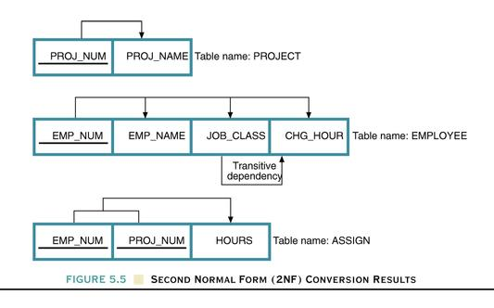
Dependency Diagram

Slide 20
Second Normal Form (2 NF)
A table is in 2NF if:
It is in 1NF and
It includes no partial dependencies; that is, no attribute is dependent on only a portion of the primary key.
(It is still possible for a table in 2NF to exhibit transitive dependency; that is, one or more attributes may be functionally dependent on nonkey attributes.)

Slide 21
Third Normal Form (3 NF)
Conversion to Third Normal Form
Create a separate table with attributes in a transitive functional dependence relationship.
PROJECT (PROJ_NUM, PROJ_NAME)
ASSIGN (PROJ_NUM, EMP_NUM, HOURS)
EMPLOYEE (EMP_NUM, EMP_NAME, JOB_CLASS)
JOB (JOB_CLASS, CHG_HOUR)

Slide 22
Third Normal Form (3 NF)
3NF Definition
A table is in 3NF if:
It is in 2NF and
It contains no transitive dependencies.

Slide 23
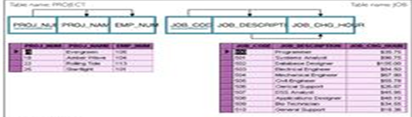
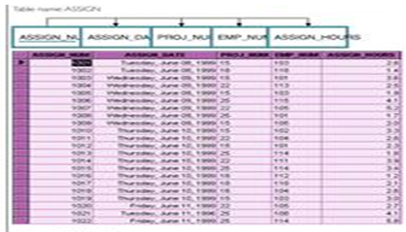
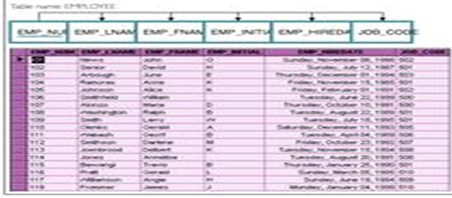
The Completed Database

Slide 24
Exercise 1
A
B
C
D
E
F
G

Slide 25
Exercise 2
Member Cod | Skill Code | Skill Type | Title | Name | Last Name | Age | Group Code | City Code | Post Code

